Slide 1
Location based Android App (Maps)
Project By:
Benita Rego (8362)
Nolita Rego (8363)
Under the Supervision of:
Prof. Dipali Koshti

Slide 2
Problem Statement:
To develop an Android Application on Location Based Services i.e. searching desired location on the map.

Slide 3
What are Location Based Services and why it is used in our project?
Location Based Services (LSB) serves to provide information to the android user based on their searched location using GPS on the android device.
Mostly these services are provided online i.e. depends on the internet and thus have limited use in case of limited connectivity.
Our project uses LSB and Internet for accessing the desired location of the user.

Slide 4
Objectives:
To design a simple model for Location Based Application Development.
To provide users with location based on the location they search. This includes searching locations like streets, buildings, cities, countries, etc.
To provide users easy access of location with automatic zoom and find the exact place of interest.

Slide 5
Approach to the given problem:
We created a project on Android Studio with minimum API level 15:Android 4.0.3 (IceCreamSandwich) using Java language.
For layouts: activity_maps.xml → search.xml
For Java: MapsActivity.java → Search.java

Slide 6
In the AndroidManifest file, permissions used: INTERNET, ACCESS_FINE_LOCATION, ACCESS_NETWORK_STATE, ACCESS_COARSE_LOCATION, WRITE_EXTERNAL_STORAGE.
For Google Maps API key, to run the application we created a credential using the package name and SHA certificate fingerprint and used the API key in the application (google_maps_api.xml).

Slide 7
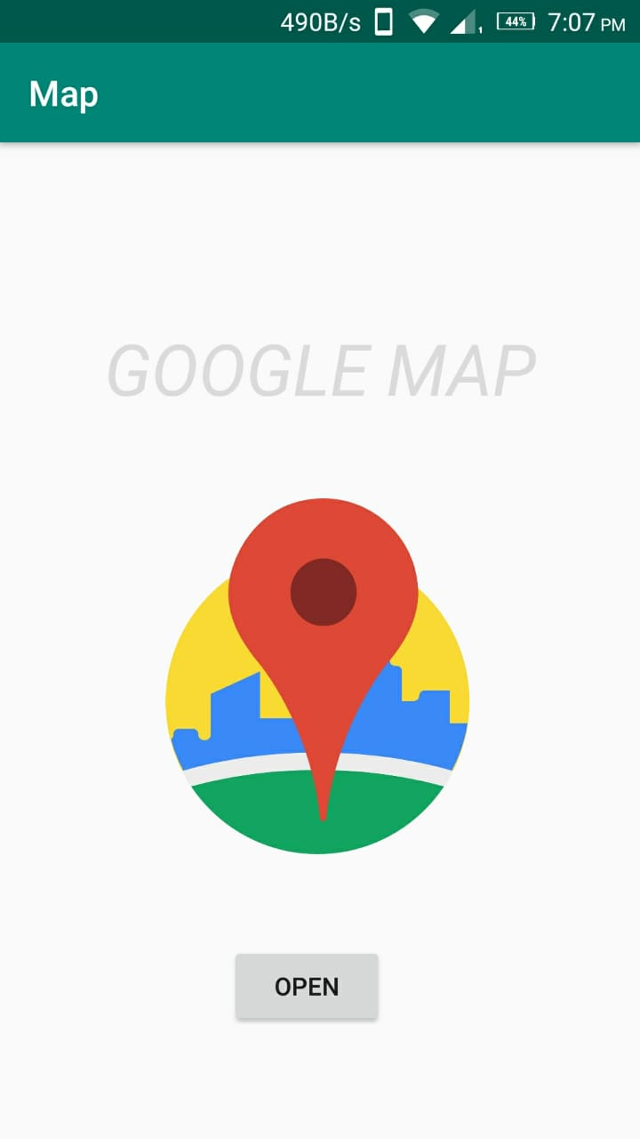
Running of the Android App:
Click on the Android App and it gives us the first display screen.
Click ‘Open’ button.

Slide 8
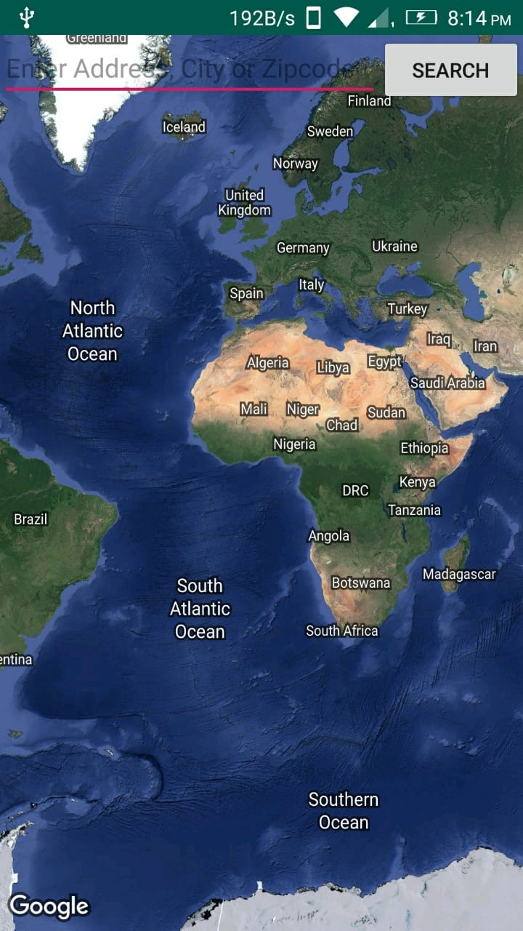
3. After clicking ‘Open’ button, it opens a map with a Search bar on the top to type the desired location which the user wants to see on the map.
4. After typing the location, click on ‘Search’ button.

Slide 9
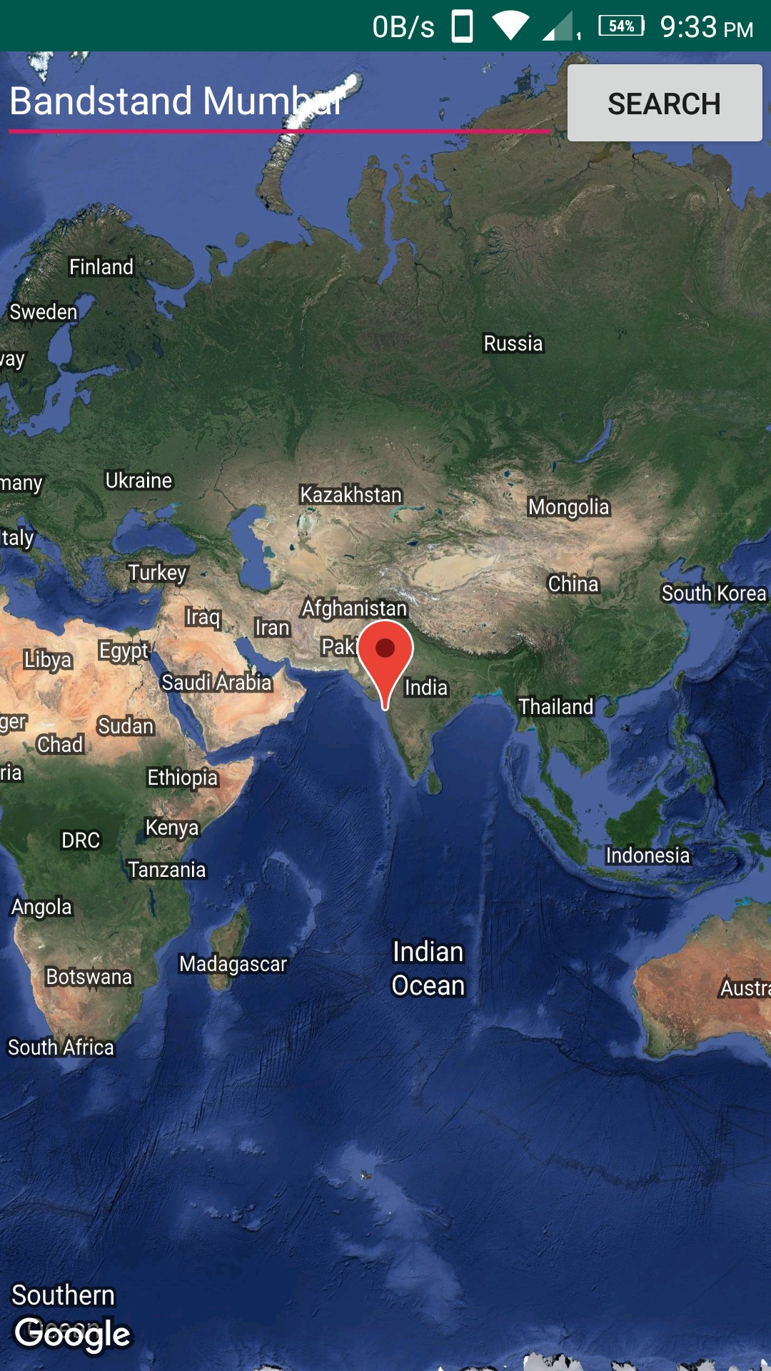
5. After clicking ‘Search’ button, the searched location zooms automatically and is marked on the map with the help of marker.
We can search any location on the Search bar. For instance, here we have typed ‘Bandstand Mumbai’ on the search bar. After clicking on search button, the marker marks the zoomed location i.e.‘Bandstand Mumbai’ on the map.

Slide 10
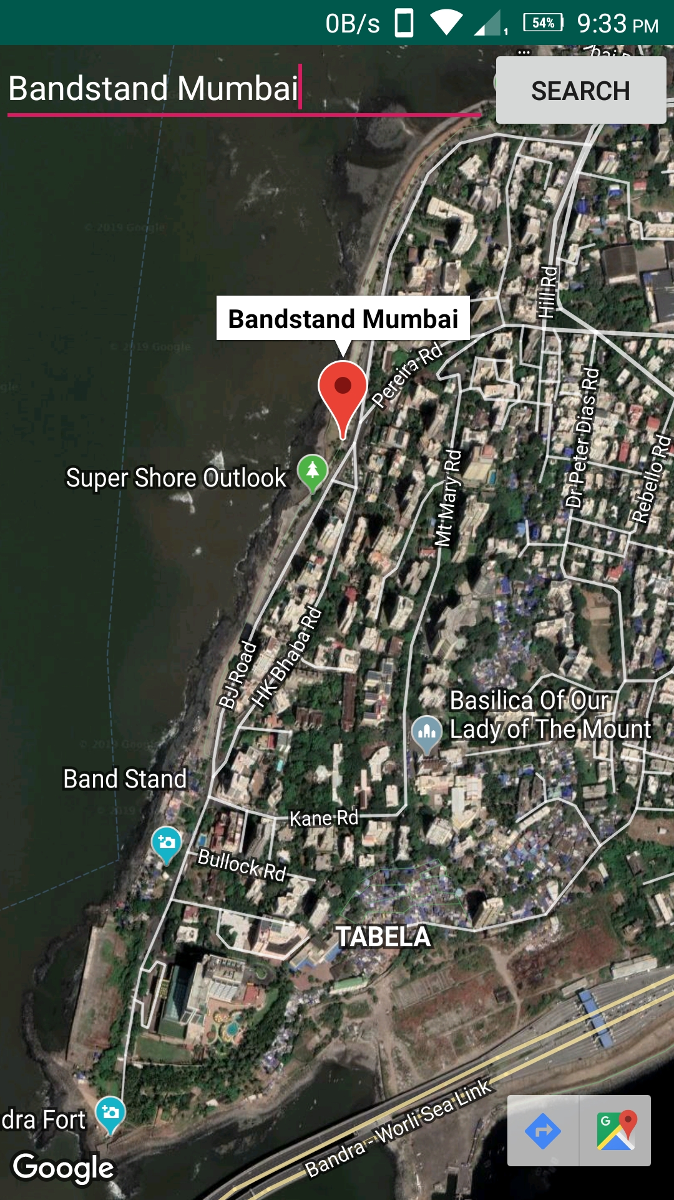
6. The location is zoomed automatically and we can also see the nearby streets/lanes along with institutions, outlooks,etc.

Slide 11
Conclusion:
We have successfully made a Location based Android App which can search any location and give the user their desired location using Location Based Services and Internet.

